Slide 1










Software Technologies
Course Overview
Software Technologies
SoftUni Team
Technical Trainers
Software University
http://softuni.bg

Slide 2

Table of Contents
Course Objectives
Course Program
Trainers Team
Course Schedule
Exams and Evaluation
Learning Resources

Slide 3
Have a Question?
sli.do #tech-softuni

Slide 4



Software Technologies
Software Technologies
Course Objectives & Program

Slide 5
Course Objectives
The Software Technologies course provides the first steps in 4 technologies:
Web development with PHP
Web development with JavaScript
Web development with C#
Web development with Java

Slide 6
Warning: This Course is at Very Basic Level
The course is very introductory
It will NOT teach you in HTML, CSS, JavaScript, PHP, MySQL, .NET, SQL Server, Entity Framework, ASP.NET MVC, Java, Hibernate and Spring MVC
It will make you familiar with these technologies
You get an idea how these technologies work
You will touch all of them in 3 months
You will create a simple blog system

Slide 7
Course Topics
Part I – PHP & MySQL
XAMPP, PHP 7, MySQL, Doctrine, Symfony
Creating a blog with Symfony and MySQL
Part II – JavaScript and MongoDB
ES6, Node.js, Express.js, MongoDB
Creating a blog with Express.js and MongoDB

Slide 8
Course Topics (2)
Part III – Java Web Development
Java 8, Hibernate and Spring MVC
Creating a blog with Spring MVC and Hibernate
Part IV – C# Web Development
C# 6, Entity Framework, ASP.NET MVC and SQL Server
Creating a blog with ASP.NET MVC and EF

Slide 9
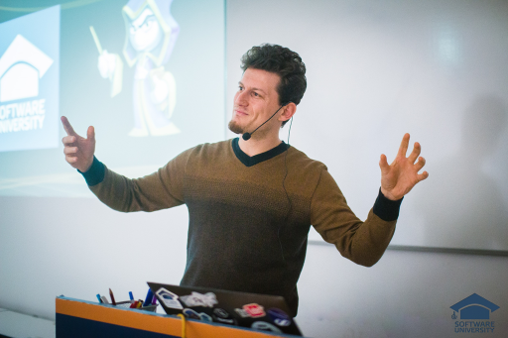
The Trainers Team

Slide 10


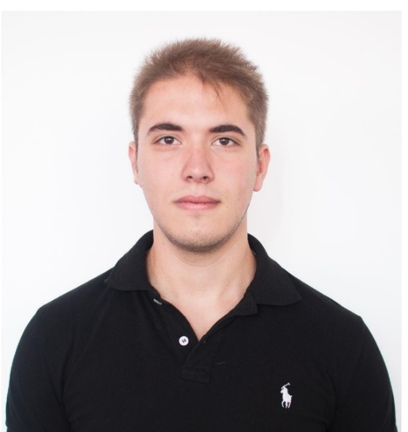
Trainers Team
Ivaylo Kenov
Senior Software Engineer & Trainer
https://github.com/ivaylokenov
Vladimir Damyanovski
Junior Trainer
Ivo Zhelev
Junior Trainer

Slide 11
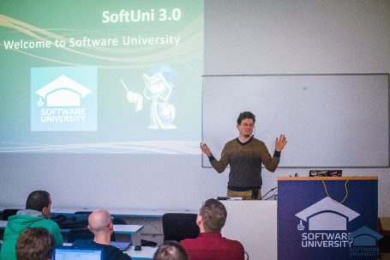


Software Technologies
Course Details and Schedule

Slide 12
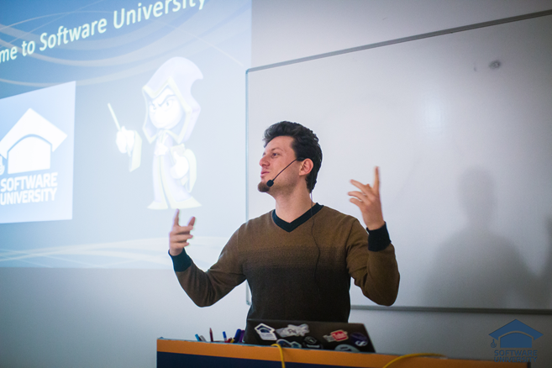
Training Duration and Schedule
Lessons: ~ 56 hours (onsite + YouTube videos)
Practical exercises (in class): ~ 112 hours
Project defense: 0.2 hours
Allocation
Timeframe: February – April 2017
Teamwork Defense : 28-29 April 2017

Slide 13


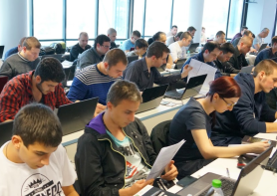
Software Technologies
Evaluation Criteria

Slide 14



Scoring System for the Course
Practical project – 90%
Exercise submissions – 10%
Forum activity – bonus up to 10%
Presence in class – 5% bonus

Slide 15


Homework Assignments
Your homework is mainly work in class!
Lesson days → live workshop
Exercise days → only exercises
How to submit your homework?
Some submitted in the judge system
Others uploaded in the course Web site
Homework assignments are due in 1 week

Slide 16

Teamwork / Practical Project
Choose one of the technologies
JS, PHP, C# or Java
Build a team or work alone
Choose your teammates
Develop a practical project
Choose from existing projects
Or work on your own idea
Public defense → demonstrate your work live at SoftUni

Slide 17










Resources
What We Need Additionally?

Slide 18

Course Web Site & Forums
The Programming Basics official web site:
Register for the "Software University Forum":
Discuss the course exercises with your colleagues
Find solutions for all course exercises
Share source code / discuss ideas / help each other
https://softuni.bg/courses/software-technologies
https://softuni.bg/forum/categories/45

Slide 19

The Software Technologies Slides and Videos
All lecture slides, videos, homework assignments, projects and other resources are open content, available for free
Visit the course web site to access the course resources

Slide 20




Recommended Software
Software needed for this course:
WebStorm – https://jetbrains.com/webstorm/ – for JS
PhpStorm – https://jetbrains.com/phpstorm/ – for PHP
Visual Studio – https://www.visualstudio.com – for .NET
IntelliJ Idea – https://www.jetbrains.com/idea/ – for Java

Slide 21









Software Technologies – Course Intro
https://softuni.bg/courses/software-technologies

Slide 22
License
This course (slides, examples, demos, videos, homework, etc.) is licensed under the "Creative Commons Attribution-NonCommercial-ShareAlike 4.0 International" license

Slide 23





Trainings @ Software University
Software University Foundation – softuni.org
Software University – High-Quality Education, Profession and Job for Software Developers
softuni.bg
Software University @ Facebook
facebook.com/SoftwareUniversity
Software University Forums – forum.softuni.bg

